Slide 1


Data Analyzation Report

Slide 2


Today's agenda
Project recap
Problem
The Analytics team
Process
Insights
Summary

Slide 3

To start our engagement with Social Buzz, we are running a 3 month initial project in order to prove to them that we are the best firm to work with. They are expecting the following:
An audit of their big data practice
Recommendations for a successful IPO
- An analysis of their content categories that highlights the top 5 categories with the largest aggregate popularity
Project Recap

Slide 4

Problem
Due to their rapid growth and digital nature of their core product, the amount of data that they create, collect and must analyze is huge.
Every day over 100,000 pieces of content, ranging from text, images, videos and GIFs are posted. All of this data is highly unstructured and requires extremely sophisticated and expensive technology to manage and maintain.
Out of the 250 people working at Social Buzz, 200 of them are technical staff working on maintaining this highly complex technology.

Slide 5



Andrew Fleming
(Chief Technical Architect)
The Analytics team
Marcus Rompton
(Senior Principle)
Sean Zhang
(Data Analytics)

Slide 6
Process
1
Data Selecting
2
Data Cleaning
3
Data Analyzing
4
Data Transferring
5
Result Summarizing

Slide 7
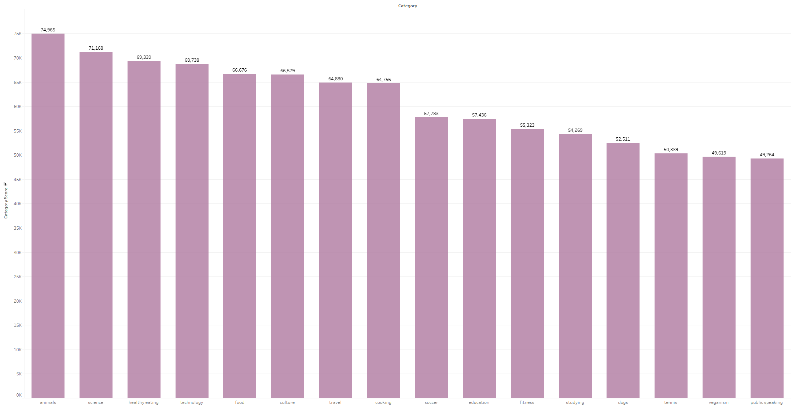

Insights: Score of total 16 Categories

Slide 8
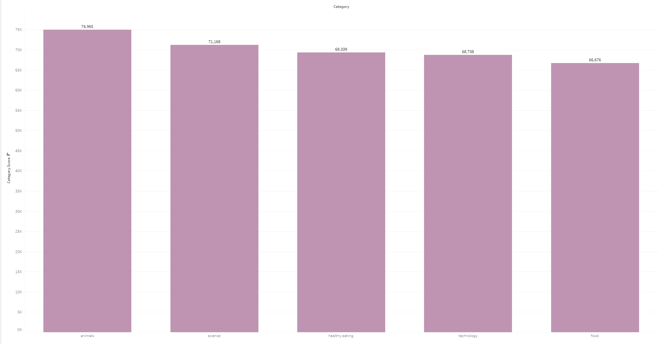
Insights: Top 5 Categories(valued by score)

Slide 9
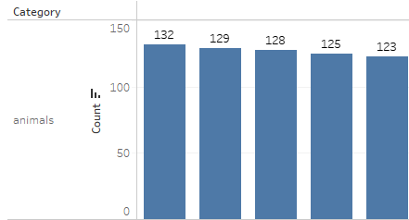
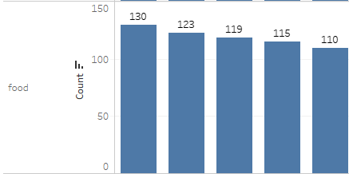
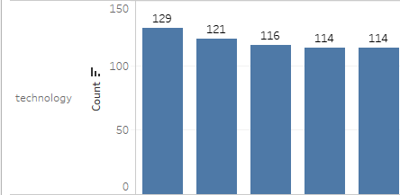
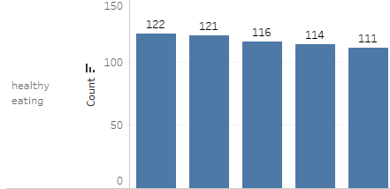
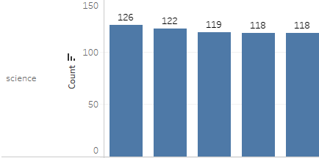



Slide 10

Top 5 Categories out of Total 16:
Animals
Science
Healthy eating
Technology
Food
Summary

Slide 11
Thank you!
ANY QUESTIONS?

